Slide 1
Read Write Create
Hook Text: How Lexi Walker Almost Saved the World
Notes:
The purpose of the lesson is to explore dialogue between Lexi and Tim. We will also recap possessive apostrophes.

Slide 2
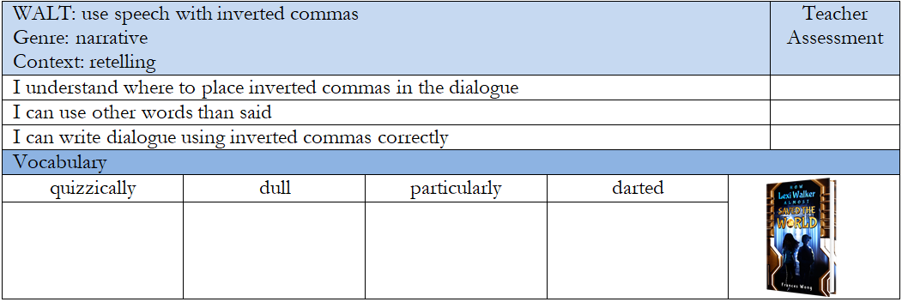
Success Criteria
Notes:
In the empty vocabulary boxes, I tend to add images that reflect the word so that children have a visual representation of what the words mean.

Slide 3
Quick Vocab Quiz
Match the vocab to the definition
quizzically particularly dull darted
Lacking interest, excitement, or brightness; uninteresting or monotonous. In a way that suggests puzzlement or confusion, often involving a questioning or curious expression or manner. Moved or ran quickly and suddenly in a particular direction, often with short, sudden movements. Especially, to a greater extent or degree than usual or average, or in a specific or significant way.
Notes:
Use the whiteboard pens to join the word to the definition.

Slide 4
When we use possessive apostrophes...
if it belongs to someone, we put ‘s before after their name and before the noun
Can you spot the possessive apostrophes?
Lexi’s hair Lexi’s backpack Lexi’s binoculars
Notes:
Point out how to use possessive apostrophes, model

Slide 5
When we use possessive apostrophes...
if it belongs to someone, we put ‘s before after their name and before the noun
Which possessive apostrophe is correct?
Lexi’s hair Lexi’s backpack Lexi’s binoculars
Tims’ glasses Tims ‘trainers Tim’s hair

Slide 6
When we use possessive apostrophes...
if it belongs to someone, we put ‘s before after their name and before the noun
Which possessive apostrophe is correct?
Lexi’s hair Lexi’s backpack Lexi’s binoculars
Tims’ glasses Tims ‘trainers Tim’s hair

Slide 7
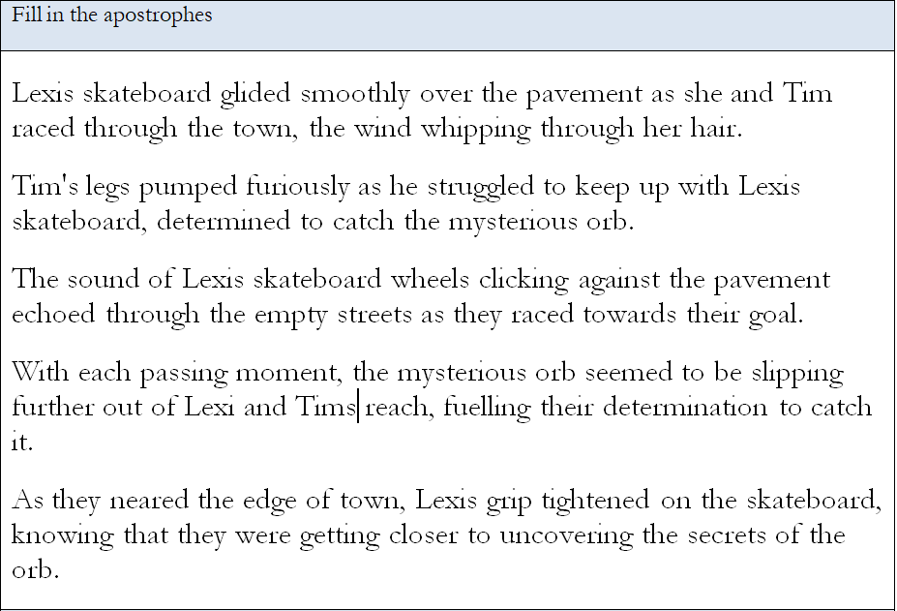
Practice adding apostrophes.
We can mark these together!
Notes:
Read through the text as a class. Ask the children to recap the rules about possessive apostrophes. Mark the work with the children and allow them to mark their own and correct their mistakes. D

Slide 8
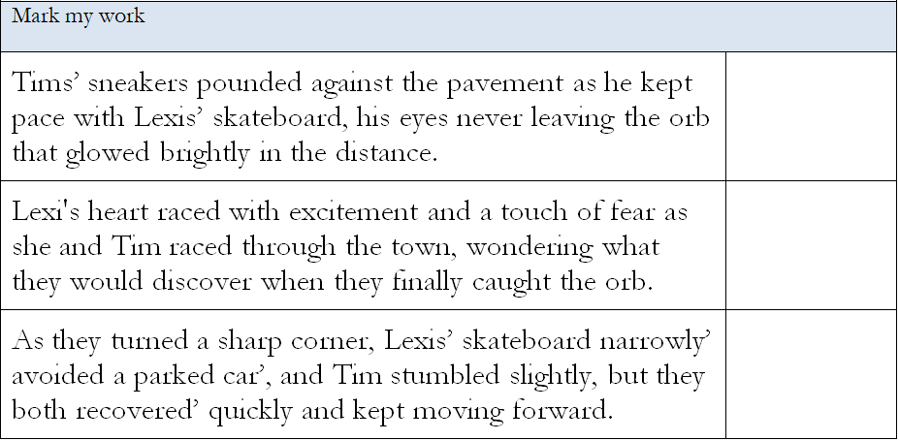
Mark my work. How did I do?
Notes:
Encourage the children to mark ‘my’ work. Ask them to point out the mistakes and discuss where the teacher has gone wrong.

Slide 9
Chapter 3
Who is Captain Blast?
What does Officer Eltran want?
Why are Lexi’s hands tingling?
What happened to Lexi and Tim at the end of the chapter?
Notes:
Read chapter 2 of How Lexi Walker Almost Saved the World to the children. (approx. 3 minutes). Discuss Lexi’s character. Discuss Tim’s personality.
Are they similar characters?
Why did the author choose these character types?
Review the pictures of Lexi and Tim. Model descriptions using similes.

Slide 10
Part of our hook lesson today is acting!
Split into groups and act out the chapter you’ve just read.
How is Lexi feeling in that chapter?
How does Tim feel?
Notes:
Reinforce possessive appostrophes

Slide 11
I know this is all a shock to you, but you must retell everything that has happened so far. Your memory wipes have failed, it is important that we fully understand what has happened. It is imperative you include as much detail as possible to explain what happened from the very start. Tim, Lexi, the orb is precious but immensely dangerous. To protect the earth, I must know everything.
Yours sincerely, Ms Boiko

Slide 12
What has Ms Boiko asked us to do?
What does ‘lots of detail’ mean?
How can we add more detail? What have we been learning about?
Writing purpose: to inform Writing outcome: retell the story of Lexi and Tim capturing the orb
Notes:
Discuss the expectation from Ms Boiko. What does she want you to do? What does it mean when she asks for lots of detail? How can we add extra detail?
Share the writing purpose with the children.
Writing Purpose: to inform
Writing Outcome: retell the story of Lexi and Tim capturing the Orb and meeting aliens

Slide 13
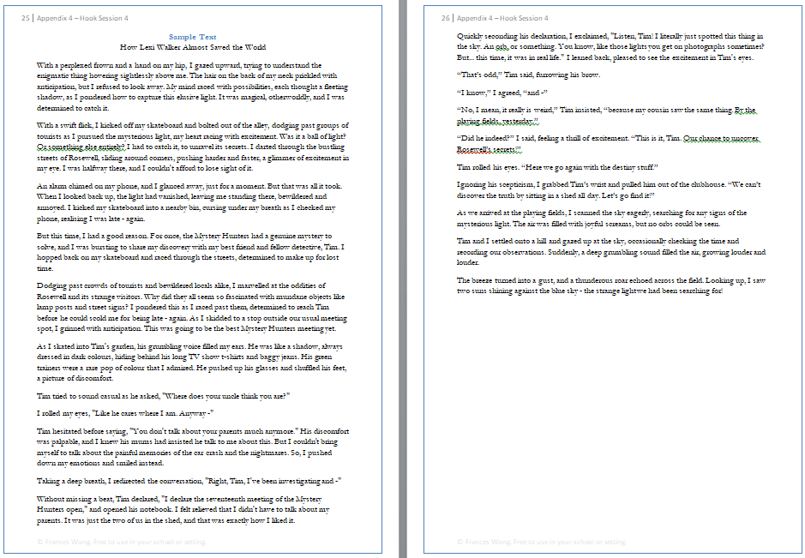
Read the example text:
Keep your eyes peeled for metaphors and similes.
Notes:
Read and explore the sample text. Discuss with the children that we will be writing in the first person and using metaphors and similes. Read, echo read, coral read and ask children to read.
Ask children to add words they want to magpie into their word banks.

Slide 14
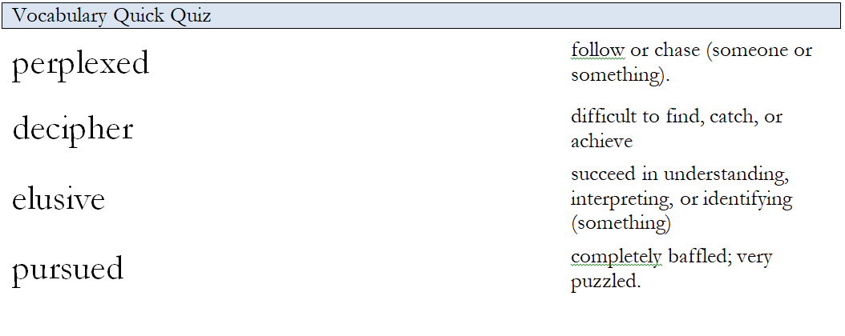
Link the word to the meaning.
We can mark these together!
Notes:
Read through the text as a class. Ask the children to recap the rules about possessive apostrophes.

Slide 15
Help me add inverted commas to this dialogue.
What is that? Tim cried.
Notes:
Encourage the children to mark ‘my’ work.

Slide 16
Can you remember the speech rules?
Starts on a new line
Begins with inverted commas
Starts with a capital letter
Ends in a comma, question mark or exclamation mark
Use another word for said
Full stop after the reporting clause

Slide 17
Mark my work:
“it’s not normal,” Tim declared.
I don’t know what you mean, Lexi objected.
“What are you doing”? Tim asked.
“I’m going in” Lexi told him
“I’m not going in there,” Tim told Lexi

Slide 18
Add inverted commas to this dialogue.

Slide 19
Acting
Imagine you’re Lexi, Tim, Officer Eltran or Captain Blast.
With your partner, act out a conversation between these two characters.
You can use the conversation in the novel or make up your own conversation.

Slide 20
Reported clause
It’s other words for he said!
Notes:
Ask the children to tell you other words for said and write them on the board here.

Slide 21
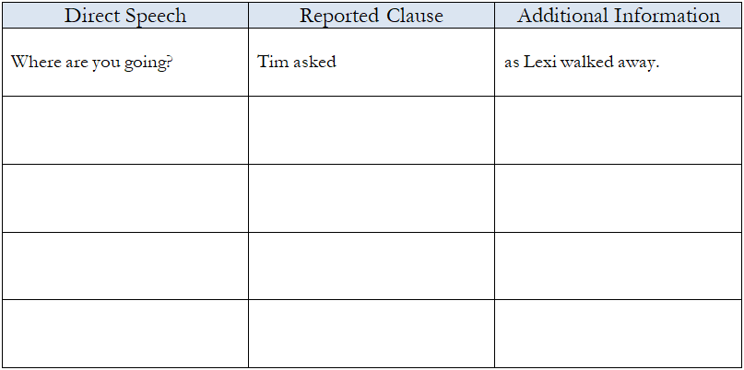
How do we fill in this sheet?
Notes:
Ask the children to tell you other words for said and write them on the board here.

Slide 22
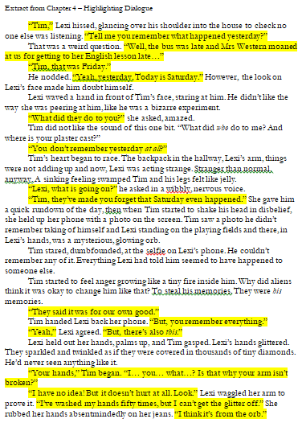
Find the reported clause.
Use the extract to find all the speech. You can use it to fill in the sheet.

Slide 23
Write a paragraph of dialogue from chapter 3.
WAGOLL
Officer Eltran’s magnificent coat flapped around her as I gazed on in amazement.
“Back off, Blast, you can’t have the Orb,” she told him. I couldn’t believe what I was hearing.
Captain Blast glared and narrowed his eyes. Grinding his teeth, he muttered, “Look, Eltran. The primitive human is holding the Orb with her hands – her bare hands.”
Officer Eltran gasped, turning on her heel. “This shouldn’t be possible!” she cried in amazement.
Notes:
On these lines, write some ideas from the children and then encourage the children to write some lines of description by themselves.

Slide 24
THANKS
Do you have any questions?
addyouremail@freepik.com
+91 620 421 838
yourcompany.com

