Slide 1
Read Write Create
Hook Text: How Lexi Walker Almost Saved the World
Notes:
The purpose of this lesson is to create an interest in the characters and to prompt the children to use imaginative language to describe the characters.

Slide 2
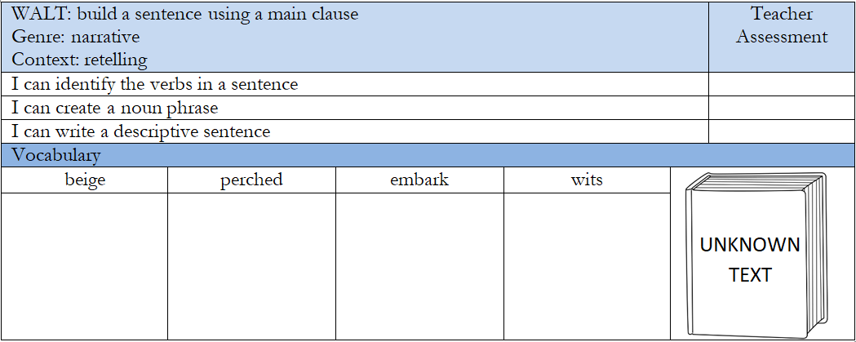
Success Criteria
Notes:
In the empty vocabulary boxes, it might be a good idea to add images that reflect the word so that children have a visual representation of what the words mean.

Slide 3
Quick Vocab Quiz
Match the vocab to the definition
beige perched embark wits
Refers to a person's mental sharpness, intelligence, or ability to think quickly and react cleverly in different situations. To be resting or situated on a high point or edge, often in a precarious or unstable way. It can also refer to a bird or other animal sitting on a branch, ledge, or other elevated surface. To start or begin a journey or a new project, usually with a sense of excitement or anticipation. It can also mean to board a ship, plane, or other mode of transportation to begin a trip. A pale, neutral colour that is often used to describe a range of light brown, greyish-yellow, or off-white shades.
Notes:
Use the whiteboard pens to join the word to the definition.

Slide 4
I have placed character photos around the room.
Have we learnt what our new book is yet? Do you think we need some more clues?
Put yourself inside the picture.
Who is this person?
What would they say?
Are they a good character or a bad one?

Slide 5
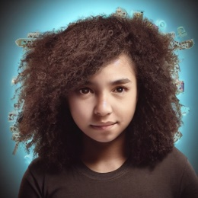
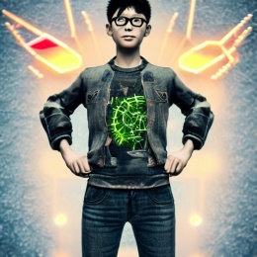
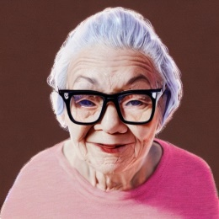
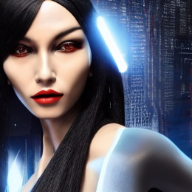
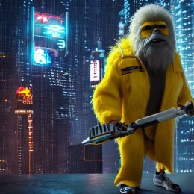
Can you match the description to the picture?
Who is it?
a strange sight on her old fashioned skateboard: jean shorts, curly hair, backpack and pink trainers.
Lexi’s wonderfully curly, brown hair bounced on her shoulders as she skilfully swept round a corner lamppost and onto the next street.
Notes:
Read through the text as a class. Ask the children to pair and square their ideas. What is this text about? Pose the questions to the children, allow them to pair and square before they share their answers. Encourage lots of collaborative learning.

Slide 6
That’s right! It’s Lexi! Well done!
Who’s next? Read the description!
Who is it?
Tim would never wear bright colours like Lexi. His green trainers were usually hidden under baggy jeans and the rest of him under long TV show T-shirts. He had straight, black hair that he liked to keep short and almost always wore a hat. He pushed his glasses up his nose.
Notes:
Read through the text as a class. Ask the children to pair and square their ideas. What is this text about? Pose the questions to the children, allow them to pair and square before they share their answers. Encourage lots of collaborative learning.

Slide 7
That’s right! It’s Tim! Well done!
Who’s next? Read the description!
Who is it?
She was short and podgy and very old, judging by her pure, white hair neatly tied up in a thick bun. She was usually dressed all in beige, reminding Lexi of a jungle explorer, except that on her feet she wore bright, pink trainers. Lexi didn’t know of any old people who wore bright, pink trainers, except for Ms Boiko. Her wise, brown eyes sparkled behind little, silver spectacles which she wore perched on the end of her nose. She was watching Lexi very carefully, as if she knew something secret and Lexi was getting closer to finding out what it was.
Notes:
Read through the text as a class. Ask the children to pair and square their ideas. What is this text about? Pose the questions to the children, allow them to pair and square before they share their answers. Encourage lots of collaborative learning.

Slide 8
That’s right! It’s Ms Boiko! Well done!
How did you know which character it was? Which words gave you the clues? What type of words are they?
Adjectives!!
Notes:
Can the children identify the adjectives in the sample descriptions of the characters. Recap that adjectives are describing words.

Slide 9
How would you describe Lexi?
Share your adjective ideas.
What words could you use to describe Lexi’s hair?
How about her eyes?
How would you describe her clothes?
Is she tall or short?
What is her personality like?
Notes:
On this slide, jot down the children’s ideas around the picture of Lexi.

Slide 10
What is an adjective?
An adjective is a describing word.
Find the describing words in this description.
Lexi's brown curly hair, charged with static energy, bounced and swirled around her like a wild solar flare, as she kicked her hover-skateboard through the throng of tourists. Her eyes, like twin black holes, were fixed on her destination, calculating every move like a supercomputer.
Her baggy orange t-shirt, emblazoned with a strange alien symbol, glowed with an otherworldly radiance, while her short cropped jeans were adorned with cybernetic enhancements that shimmered like a metallic sheen. Her bright pink trainers, powered by futuristic tech, hummed with energy and speed, propelling her forward with a jet-like thrust.
As she carved through the crowd with the fluidity of a cosmic dancer, Lexi was a being from another world, a superhuman hybrid of flesh and machine, with the agility of a cheetah and the endurance of a space explorer. She was a force of nature, a technological marvel, a symbol of hope for a universe in turmoil.
Notes:
On this slide, jot down the children’s ideas around the picture of Lexi.

Slide 11
Uplevel your adjectives!
Adjectives should create an image of what they’re describing.
These are all words we can use to describe Lexi.
Uplevel these adjectives.
happy
- jubilant, ecstatic, delighted, thrilled
brave
- fearless, valiant, dauntless, gutsy
fast
- swift, rapid, spry, fleet-footed
Notes:
On this slide, jot down the children’s ideas around the picture of Lexi.

Slide 12
Add adjectives to the sheet.
Would you use the same adjectives for her personality as her appearance?
What creative adjectives could you use to describe Lexi and Tim?
What do you think her personality would be like?
Notes:
On this slide, model to the children what they need to do on the sheet.

Slide 13
Identify the subject in my sentences.
Tim’s spiky hair stood up piercingly on top of his head.
Lexi wore ripped jeans that hung casually from her hips.
Lexi’s colourful, old skateboard flew through the city in a flash.
Notes:
Have a class discussion about the text questions. Encourage children to talk to their partners.

Slide 14
Identify the subject in my sentences.
Tim’s spiky hair stood up piercingly on top of his head.
Lexi wore ripped jeans that hung casually from her hips.
Lexi’s colourful, old skateboard flew through the city in a flash.
Notes:
Have a class discussion about the text questions. Encourage children to talk to their partners.

Slide 15
Identify the verb in my sentences.
Tim’s spiky hair stood up piercingly on top of his head.
Lexi wore ripped jeans that hung casually from her hips.
Lexi’s colourful, old skateboard flew through the city in a flash.
Notes:
Have a class discussion about the text questions. Encourage children to talk to their partners.

Slide 16
Identify the verb in my sentences.
Tim’s spiky hair stood up piercingly on top of his head.
Lexi wore ripped jeans that hung casually from her hips.
Lexi’s colourful, old skateboard flew through the city in a flash.
Notes:
Have a class discussion about the text questions. Encourage children to talk to their partners.

Slide 17
Identify the noun phrase in my sentences.
Tim’s spiky hair stood up piercingly on top of his head.
Lexi wore ripped jeans that hung casually from her hips.
Lexi’s colourful, old skateboard flew through the city in a flash.
Notes:
Have a class discussion about the text questions. Encourage children to talk to their partners.

Slide 18
Identify the noun phrase in my sentences.
Tim’s spiky hair stood up piercingly on top of his head.
Lexi wore ripped jeans that hung casually from her hips.
Lexi’s colourful, old skateboard flew through the city in a flash.
Notes:
Have a class discussion about the text questions. Encourage children to talk to their partners.

Slide 19
Identify the adverb in my sentences.
Tim’s spiky hair stood up piercingly on top of his head.
Lexi wore ripped jeans that hung casually from her hips.
Lexi’s colourful, old skateboard flew through the city in a flash.
Notes:
Have a class discussion about the text questions. Encourage children to talk to their partners.

Slide 20
Identify the adverb in my sentences.
Tim’s spiky hair stood up piercingly on top of his head.
Lexi wore ripped jeans that hung casually from her hips.
Lexi’s colourful, old skateboard flew through the city in a flash.
Notes:
Have a class discussion about the text questions. Encourage children to talk to their partners.

Slide 21
Identify the location in my sentences.
Tim’s spiky hair stood up piercingly on top of his head.
Lexi wore ripped jeans that hung casually from her hips.
Lexi’s colourful, old skateboard flew through the city in a flash.
Notes:
Have a class discussion about the text questions. Encourage children to talk to their partners.

Slide 22
Identify the location in my sentences.
Tim’s spiky hair stood up piercingly on top of his head.
Lexi wore ripped jeans that hung casually from her hips.
Lexi’s colourful, old skateboard flew through the city in a flash.
Notes:
Have a class discussion about the text questions. Encourage children to talk to their partners.

Slide 23
Creating our own sentences
Talk with your partner
Decide what you’re going to write about. Are you going to write about Lexi or Tim? How are you going to describe them?
Notes:
Work with the children to demonstrate how to fill in the sheet. Model what to put in each box. Children will build one sentence using the sheet and then write two more sentences straight into their books. Ensure children speak their sentences before they write them down.

Slide 24
We are about to see the text.
What do you think will be on the front cover?
Flowers?
Footballs?
Icecream?
Aliens?
Fairies?
Treasure maps?
Write all your ideas on this slide!
Notes:
Work with the children to demonstrate how to fill in the sheet. Model what to put in each box. Children will build one sentence using the sheet and then write two more sentences straight into their books. Ensure children speak their sentences before they write them down.

Slide 25
Look at the Front Cover
What genre is the book?
What age group is the book for?
Is it a book for girls or a book for boys? (trick question)
Who is on the front cover?
Where are they going?
What do you think the word ‘almost’ means?
Notes:
Discuss the image using what we already know form our immersion into the text. Who is on the front over? What could they be doing? Use this as a discussion point for

Slide 26
Book Blurb
How does this blurb link to our predictions?
Have they been right so far?
Has your opinion changed since you heard the blurb for this book?
Notes:
Read the blurb to the children. Can the blurb give them clues about the story? Ask the children the following questions:
How does this blurb link to our predictions?
Have they been right so far?
Has your opinion changed since you heard the blurb for this book?

Slide 27
Read Chapter 1
What does ‘adult supervision’ mean?
How does Lexi feel about her uncle?
Discuss the meaning of unknown words.
Notes:
Read Chapter 1 of How Lexi Walker Almost Saved the World (Approx. 10 minutes) While reading, encourage the children to jot down words they don’t know on their word banks.
Discuss the term ‘adult supervision’.
How does Lexi feel about her uncle?
Discuss the meaning of unknown words.

Slide 28
Share your questions for the board
Now write your questions in your book.
When you find the answers, you could answer your questions.
Notes:
Write the children’s ideas on the board then encourage the children to write some questions down in their books. They could leave a space so that they can write the answers in on a separate lesson.

Slide 29
No – Good Try!
That description didn’t match the character but good try. Press the button below to go back to the previous page.

Slide 30
No – Good Try!
That description didn’t match the character but good try. Press the button below to go back to the previous page.

Slide 31
No – Good Try!
That description didn’t match the character but good try. Press the button below to go back to the previous page.

Slide 32
THANKS
Do you have any questions?
addyouremail@freepik.com
+91 620 421 838
yourcompany.com

