Slide 1
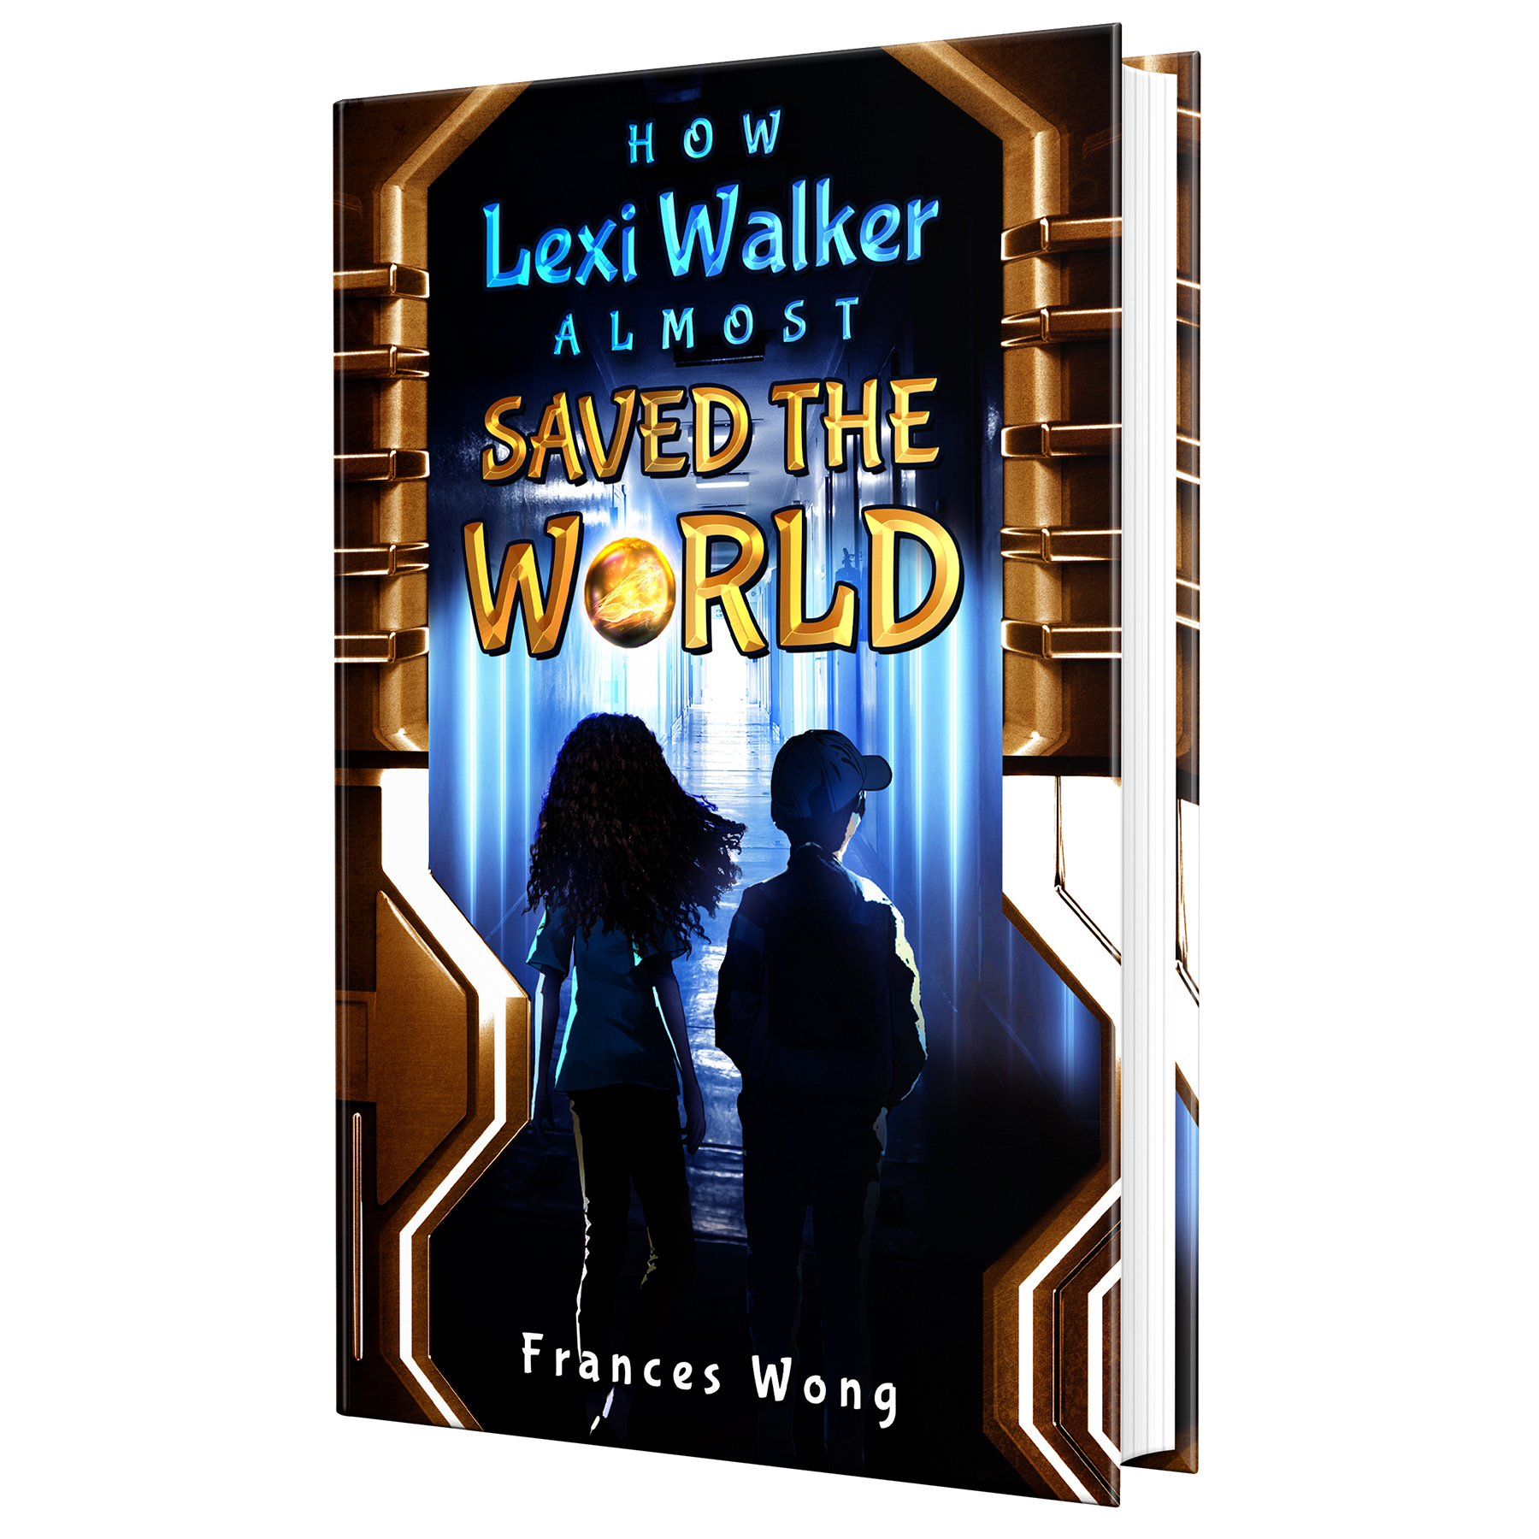
Read Write Create
Hook Text: How Lexi Walker Almost Saved the World

Slide 2
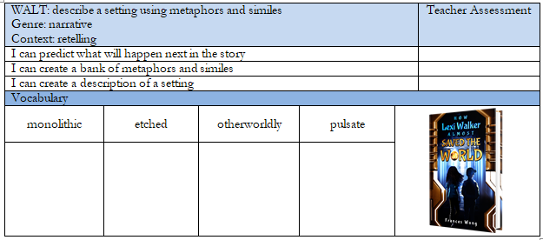
Success Criteria
Notes:
In the empty vocabulary boxes, I tend to add images that reflect the word so that children have a visual representation of what the words mean.

Slide 3
Quick Vocab Quiz
Match the vocab to the definition
monolithic etched otherworldly pulsate
refers to something that belongs or relates to a realm or world beyond the physical or observable reality, often described as supernatural or alien in nature.. refers to something that is massive, uniform, and singular in nature. means to expand and contract rhythmically or regularly, usually in a way that can be seen or felt. refers to something that has been engraved, carved, or marked onto a surface through a process of cutting or burning.
Notes:
Use the whiteboard pens to join the word to the definition.

Slide 4
Purpose and Outcome
To inform a retelling of what happened when Lexi and Tim found the Orb and met the aliens.
Notes:
Use the whiteboard pens to join the word to the definition.

Slide 5
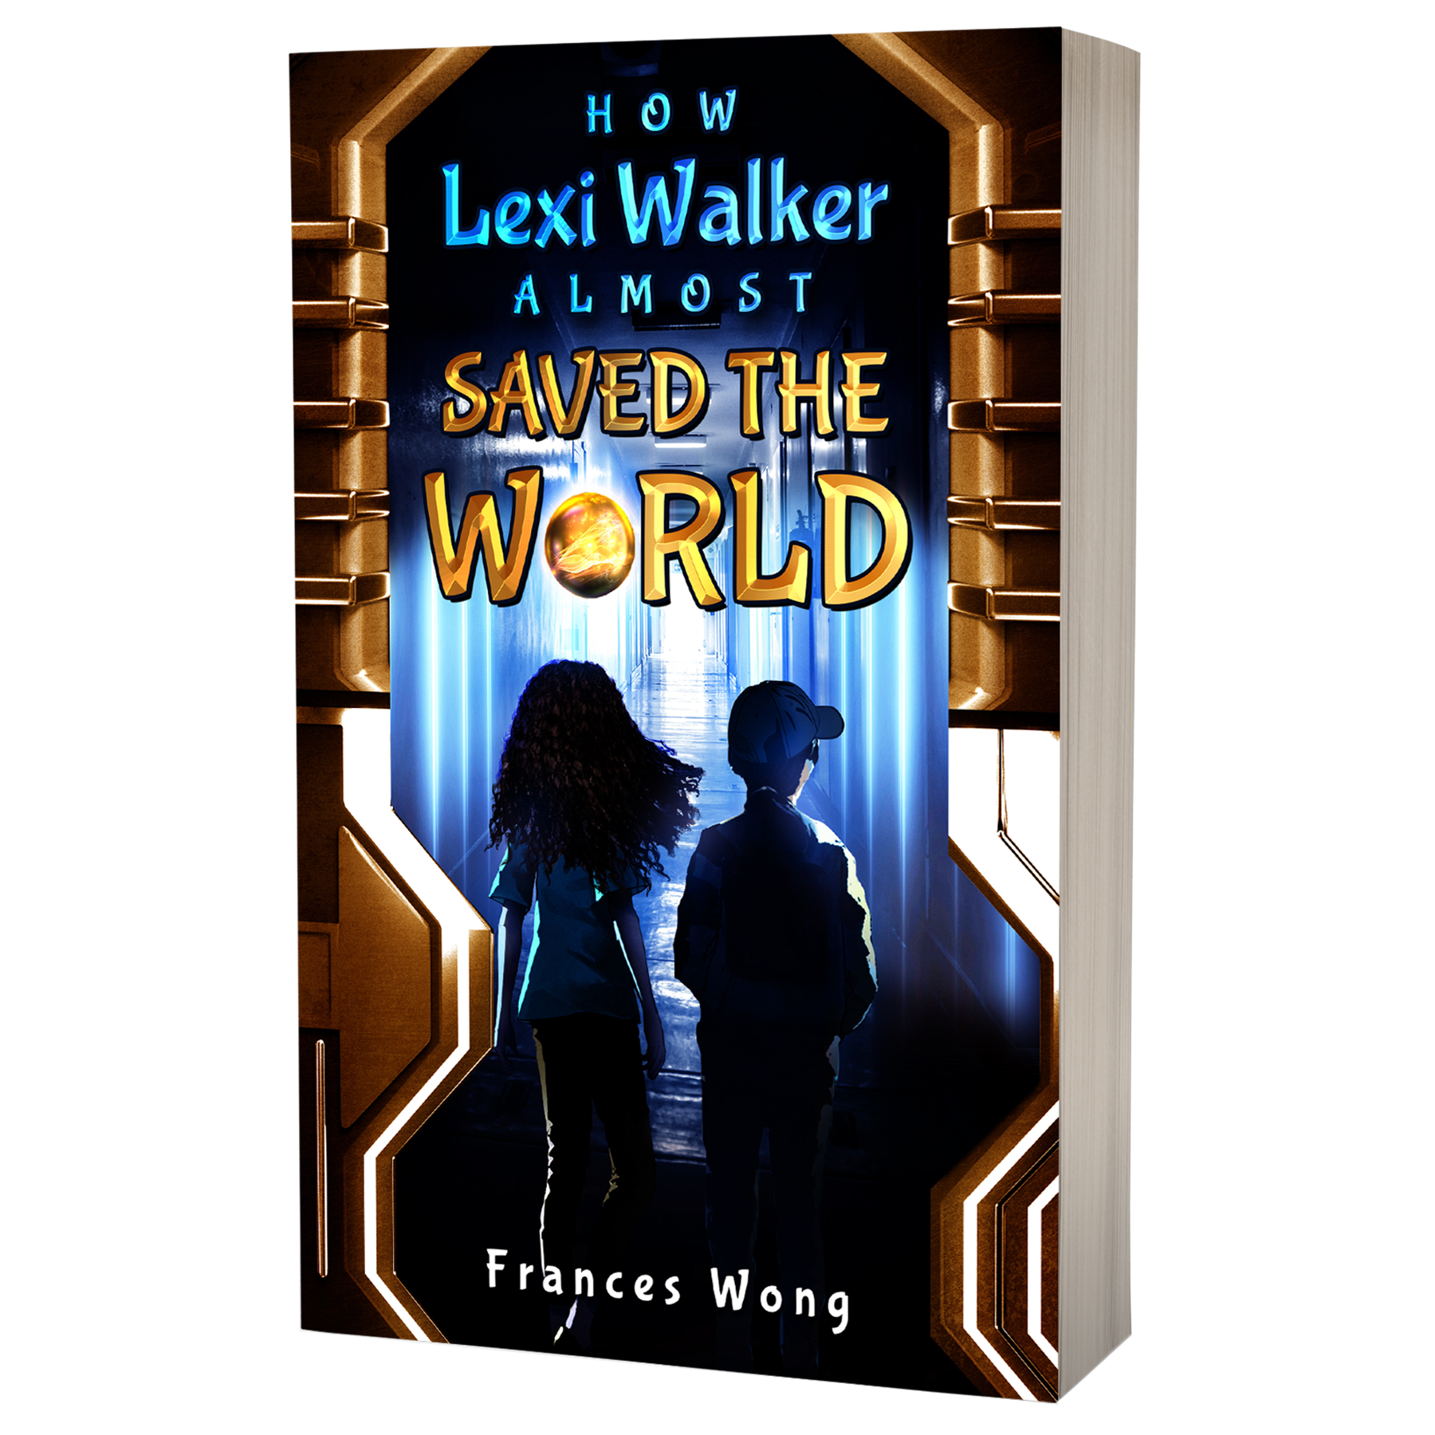
Chapter 5
What are Lexi and Tim going to see?
What will they find?
Notes:
Read chapter 2 of How Lexi Walker Almost Saved the World to the children. (approx. 3 minutes). Discuss Lexi’s character. Discuss Tim’s personality.
Are they similar characters?
Why did the author choose these character types?
Review the pictures of Lexi and Tim. Model descriptions using similes.

Slide 6
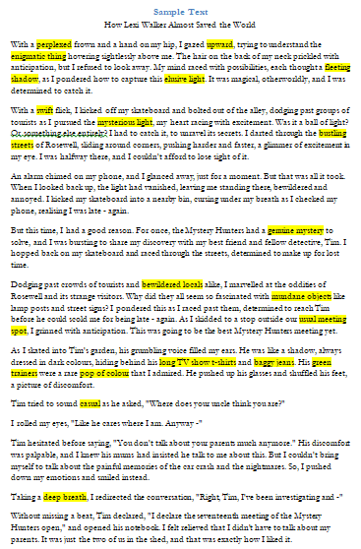
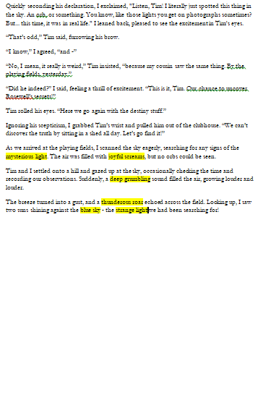
Recap: adjectives
Identify the descriptive language in the example text.
Add interesting words to your wordbank.
Notes:
Point out how to use possessive apostrophes, model

Slide 7
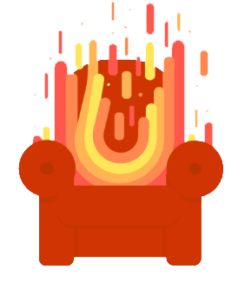
Hot Seating
How did you feel about finding the Orb? What do you plan to do with it now you’ve caught it? Will you go with Lexi/Do you think Tim will stick with you?

Slide 8
Reread for questions:
Why was Lexi angry in that moment?
Does Lexi have a reason for built up anger?
What will Lexi and Tim find on the other side of the waterfall?
Notes:
Re read chapter 5 from ‘with anger roaring up inside her’ to the end.

Slide 9
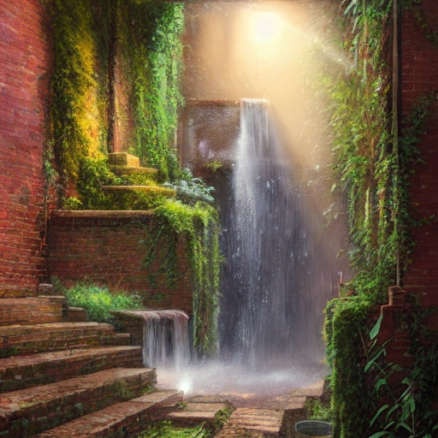
What will they find on the other side of the waterfall?
Make your preditcions.
Notes:
Discuss all the children’s different ideas they came up. Can they use examples from the text to back up their predictions? Refer back to the blurb in a previous lesson, can children use the blurb as a reason for their predictions.

Slide 10
We’re going to describe what they find using metaphors!
But... What is a metaphor?
A metaphor is a way of talking about something by saying it is something else. It helps us understand things that might be hard to explain by comparing them to something we already know. For example, if we say "He has a heart of gold," we mean that he is a very kind person, even though he doesn't really have a heart made of gold.
Notes:
Ask the children to answer, what a metaphor is and can they think of any examples.

Slide 11
We’re going to describe what they find using metaphors!
Write a metaphor that describes the corridor.
Write a metaphor that describes the waterfall.
The walls towered over me.
The walls pulsated with eerie otherworld strangeness.
The doors stood to the side.
Churning water cascaded from the ceiling.
The giant wall of water tumbled to the ground.
The thunderous roar of the water echoed through the alley.
Notes:
Use this page to add ideas of different metaphors the children could use. You could use the examples here, or delete them and add your own.

Slide 12
In your books create a list of metaphors.
Metaphors
The walls towered over me like monolithic giants.
Notes:
Use this page to help the children collect a list of metaphors they could use to describe what they think they could find behind the waterfall. A complete list of suggested metaphors can be found in the planning pages but you could also suggest:
The walls towered over me like monolithic giants.
The jagged edges of the walls resembled teeth ready to clamp down on any unsuspecting intruder.
The floor beneath my feet felt slick and slimy, like walking on a freshly caught fish.
The silence was deafening, broken only by the soft sound of my own footsteps echoing off the walls like a timid mouse scurrying for cover.
The air was thick and heavy, like a wet blanket wrapped around my face, making it difficult to breathe.
Strange symbols etched into the walls seemed to glow with an eerie blue light, casting long shadows that stretched out like the tentacles of some unknown creature.
Every step I took felt like a leap into the unknown, as if I were exploring an alien planet where danger lurked around every corner.
The corridor was like a maze, with twists and turns that seemed to lead nowhere.
The atmosphere was charged with an otherworldly energy, like standing in the eye of a cosmic storm.
The walls seemed to pulsate with a strange, otherworldly glow, like they were alive and watching my every move.

Slide 13
We’re also going to use similes!
What is a simile?
A simile is a figure of speech that compares two things using the words "like" or "as." It's a way of describing something by saying it is similar to something else. Similes help us to understand and visualize things by comparing them to something we already know. For example, "Her hair is as bright as the sun" is a simile that compares the brightness of someone's hair to the brightness of the sun.
Notes:
Reinforce possessive appostrophes

Slide 14
We’re going to use similes to describe what Lexi and Tim find.
Write a simile that describes the corridor.
Write a simile that describes the waterfall.
The shadows were as dark as night.
The corridor stretched off like a snake.
I saw walls that were as tall as a mountain.
The water poured like heavy rain.
I saw thick, wide drops as big as stones.
Tim pressed his hand into the water capturing water that glittered like diamonds.
Notes:
Use this page to add ideas of different metaphors the children could use. You could use the examples here, or delete them and add your own.

Slide 15
In your books create a list of similes.
Similes
The walls towered over me like monolithic giants.
Notes:
Use this page to help the children collect a list of metaphors they could use to describe what they think they could find behind the waterfall. A complete list of suggested metaphors can be found in the planning pages but you could also suggest:
The walls towered over me like monolithic giants.
The jagged edges of the walls resembled teeth ready to clamp down on any unsuspecting intruder.
The floor beneath my feet felt slick and slimy, like walking on a freshly caught fish.
The silence was deafening, broken only by the soft sound of my own footsteps echoing off the walls like a timid mouse scurrying for cover.
The air was thick and heavy, like a wet blanket wrapped around my face, making it difficult to breathe.
Strange symbols etched into the walls seemed to glow with an eerie blue light, casting long shadows that stretched out like the tentacles of some unknown creature.
Every step I took felt like a leap into the unknown, as if I were exploring an alien planet where danger lurked around every corner.
The corridor was like a maze, with twists and turns that seemed to lead nowhere.
The atmosphere was charged with an otherworldly energy, like standing in the eye of a cosmic storm.
The walls seemed to pulsate with a strange, otherworldly glow, like they were alive and watching my every move.

Slide 16
Write a description of what Lexi and Tim find behind the waterfall.
WAGOLL
As I cautiously stepped into the unfamiliar corridor, the walls towered over me like monolithic giants, their jagged edges resembling teeth ready to clamp down on any unsuspecting intruder. The floor beneath my feet felt slick and slimy, like walking on a freshly caught fish.
As I moved forward, the silence was deafening, broken only by the soft sound of my own footsteps echoing off the walls like a timid mouse scurrying for cover. The air was thick and heavy, like a wet blanket wrapped around my face, making it difficult to breathe.
As I looked around, strange symbols etched into the walls seemed to glow with an eerie blue light, casting long shadows that stretched out like the tentacles of some unknown creature.
Every step I took felt like a leap into the unknown, as if I were exploring an alien planet where danger lurked around every corner. I felt like a tiny ant wandering through a vast, unknown world, where even the smallest misstep could lead to my demise.
Despite the fear that gripped me, I couldn't help but feel a sense of wonder and awe at the strange and mysterious world I found myself in. Each step brought me closer to discovering the secrets of this strange, alien corridor, and I couldn't wait to uncover what lay ahead.
Notes:
On these lines, write some ideas from the children and then encourage the children to write some lines of description by themselves.

Slide 17
THANKS
Do you have any questions?
addyouremail@freepik.com
+91 620 421 838
yourcompany.com

