Slide 1
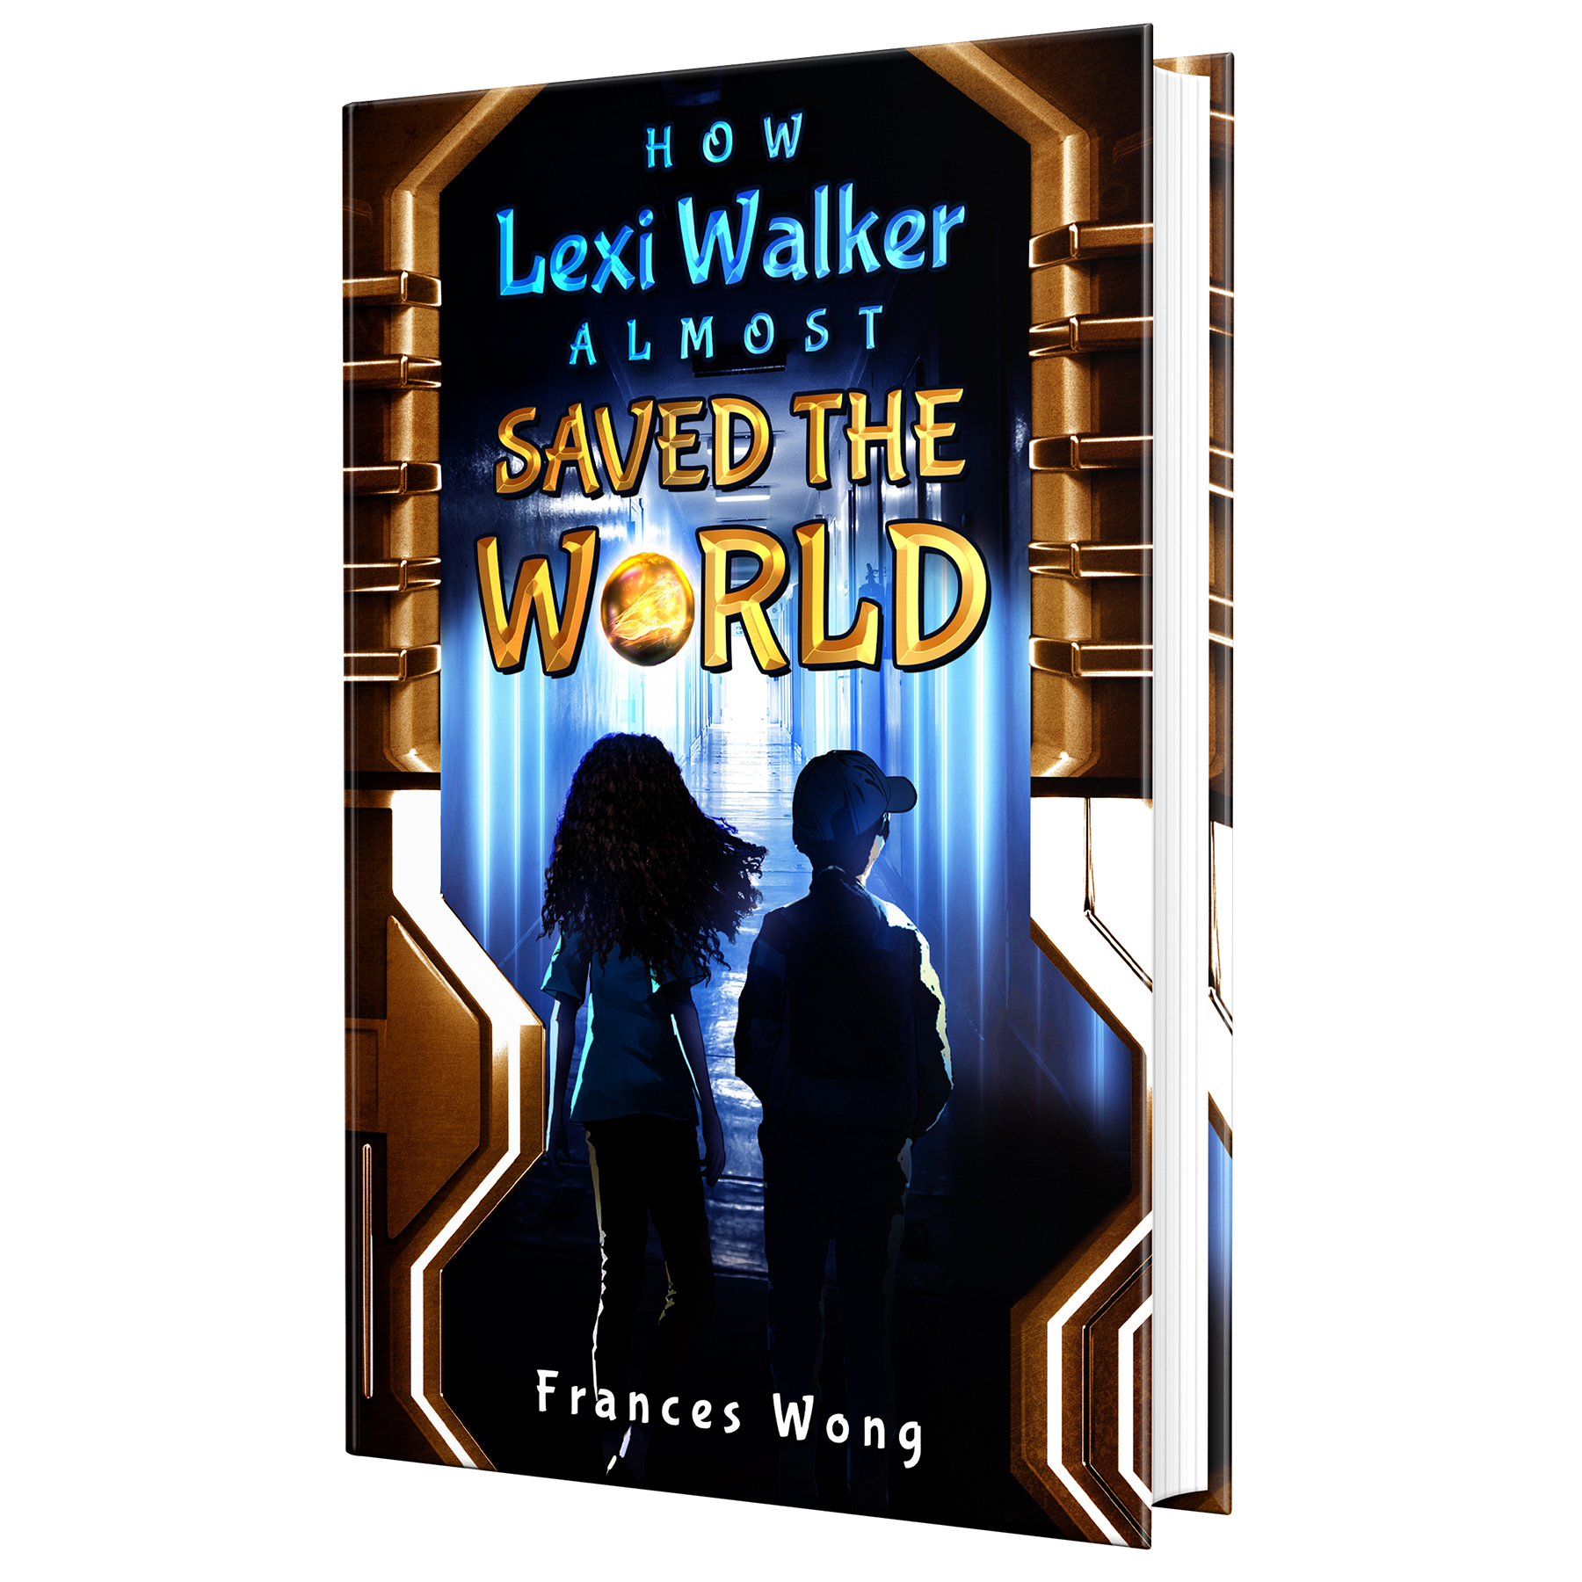
Read Write Create
Hook Text: How Lexi Walker Almost Saved the World

Slide 2
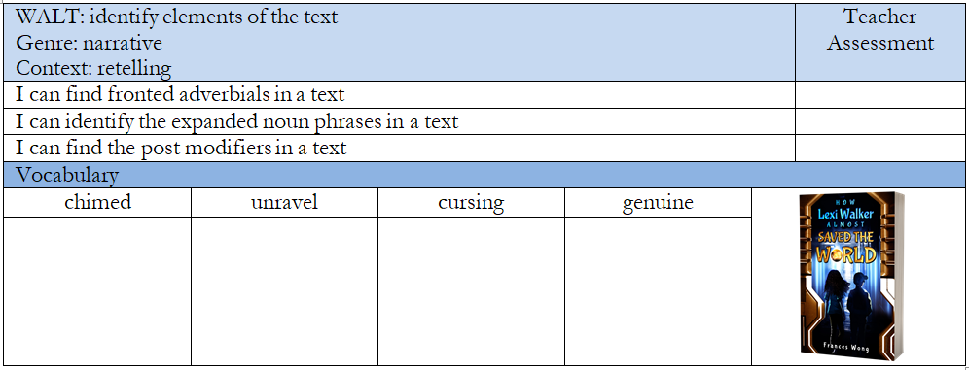
Success Criteria
Notes:
In the empty vocabulary boxes, I tend to add images that reflect the word so that children have a visual representation of what the words mean.

Slide 3
Quick Vocab Quiz
Match the vocab to the definition
chimed unravel cursing genuine
the use of such language by children, which can include using words that are disrespectful, hurtful, or inappropriate. serve as a signal or announcement, such as indicating the start or end of an event or marking the time of day. that something is real, authentic, or sincere. o undo or untangle something that is twisted or knotted.
Notes:
Use the whiteboard pens to join the word to the definition.

Slide 4
Purpose and Outcome
To inform a retelling of what happened when Lexi and Tim found the Orb and met the aliens.
Notes:
Reinforce the purpose of the lesson.

Slide 5
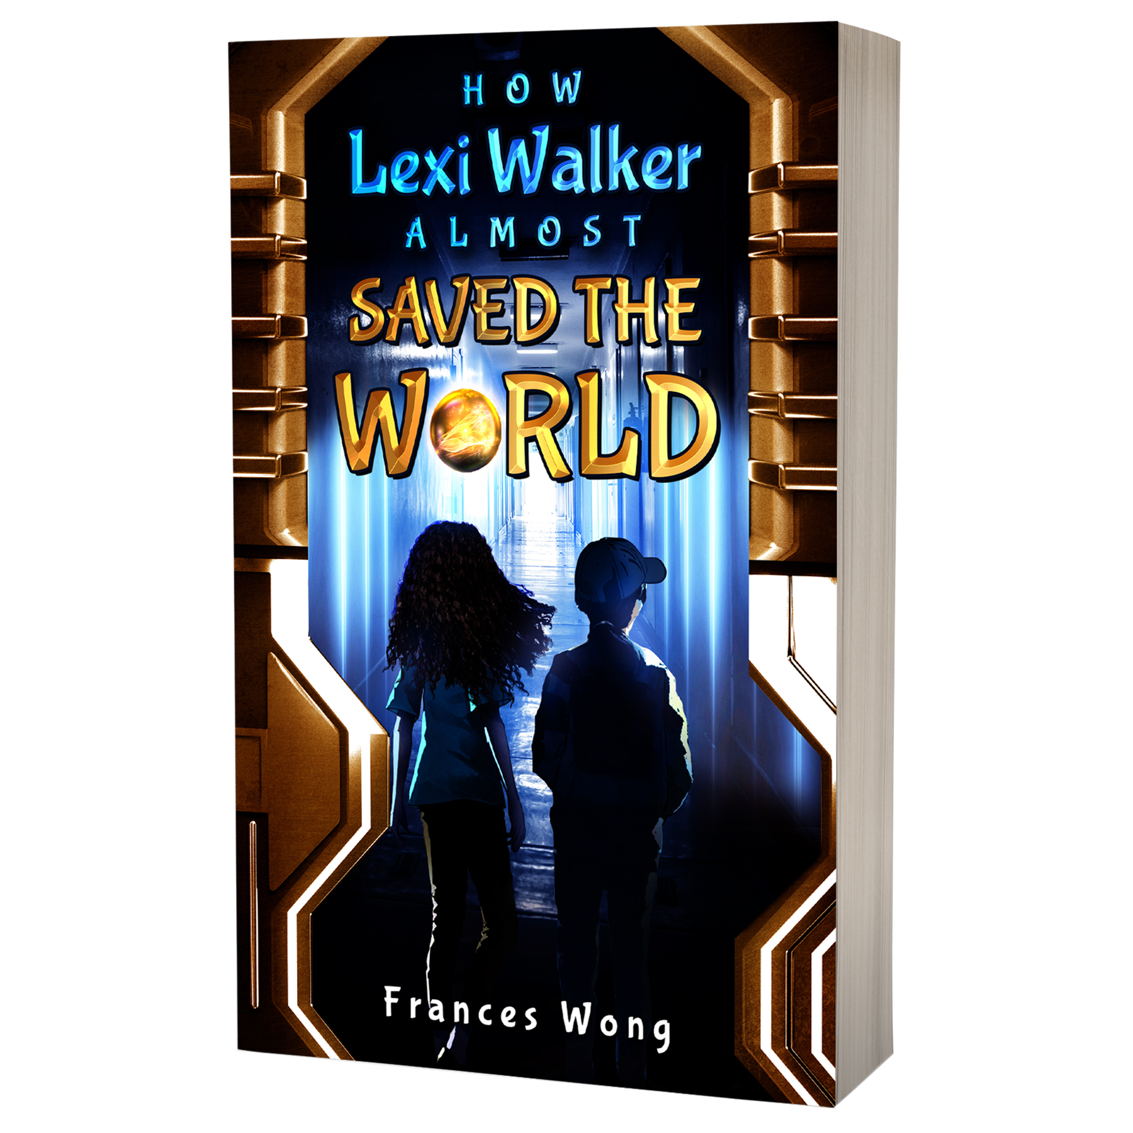
Chapter 8
Can you find:
A fronted adverbial
An expanded noun phrase
A subordinating conjunction starting a sentence
A subordinating conjunction in the middle of a sentence
An interesting or unusual verb
An interesting or unusual adjective
A question
Emotional language
An example of speech
Notes:
Read the book twice. On the second read, play a spotter game with the children and see if they can identify the following in the book:
A fronted adverbial
An expanded noun phrase
A subordinating conjunction starting a sentence
A subordinating conjunction in the middle of a sentence
An interesting or unusual verb
An interesting or unusual adjective
A question
Emotional language
An example of speech

Slide 6
Recap:
Expanded noun phrase
Fronted adverbial
Subordinate clause
We saw the bright, glowing orb racing towards us.
Incredibly, we saw the bright, glowing orb racing towards us.
Incredibly, we saw the bright, glowing orb racing towards us as it roared through the sky..

Slide 7
What is a post modifier?
A post modifier provides information after the noun.
The easiest way to use a post modifier is to say...
who was that was which was
The orb, which was flying towards us, shone like the sun. My heart that was pounding within my chest was twisted in two. Tim, who was my best friend, stood beside me.

Slide 8
Recap: Simile
Can you explain what a simile is?
A simile compares something to something else to help us understand what it looks like better.
My heart froze like ice. The orb thundered overhead like a rocket. The orb shone like sunshine. My voice croaked like a frog.
Notes:
Ask the children to answer, what a simile is and can they think of any examples.

Slide 9
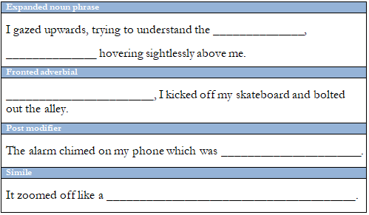
Complete the sheet:

Slide 10
Class Discussion:
Why do you think the author chose these words for the example text?
How does Lexi feel at the beginning of the story?
What is Lexi worried about?
Who is she going to meet?
What does Tim ask about when Lexi arrives at the Mystery Hunters meeting?
How many Mystery Hunter meetings have there been?
Where did Lexi and Tim go to find the orb?

Slide 11
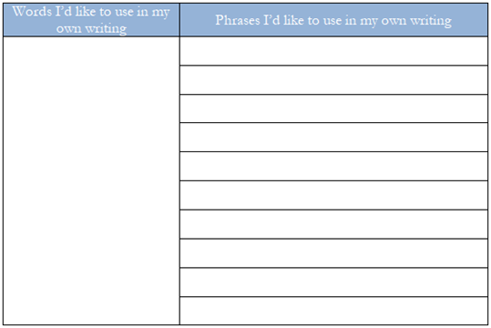
Ideas collector:
Notes:
On this final sheet, ask children to scour the example text and pick out words and phrases that they would really like to use in their own writing. Encourage children not to simply copy from the example text but to think of ideas and places they could use those words and phrases. When writing their stories in the ‘write’ section, children could neatly tick off these collected words and phrases as they use them in their final piece.

Slide 12
THANKS
Do you have any questions?
addyouremail@freepik.com
+91 620 421 838
yourcompany.com

